Slide 1
CS 6476 Project 1
Warning: Do not delete slides. This includes extra credit slides and any problems you do not complete. All problems, including extra credit, must be assigned to a slide on Gradescope. Failure to follow this will result in a penalty
Anirudh Arunkumar
anirudh.arunkumar@gatech.edu
aarunkumar8
903572206

Slide 2
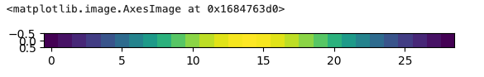
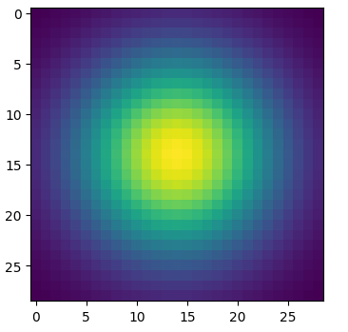
Part 1: Image filtering
[insert visualization of Gaussian kernel from project-1.ipynb here]
1D:
2D:
my_conv2d_numpy() takes the image of shape m, n, c and kernel of shape k, j which is the kernel’s height and width. I add zero padding so that the dimensions are preserved using floor division operator on k and j and np.pad(). I then iterate over every pixel in the image and take the local region to perform element-wise multiplication for all channels as well. This approach filters the image.

Slide 3
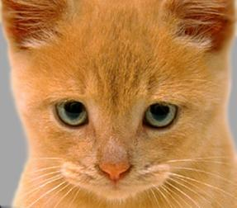
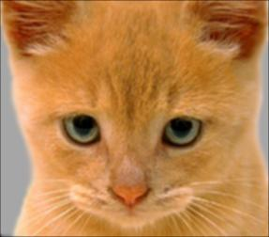
Part 1: Image filtering
Identity filter
[insert the results from project-1.ipynb using 1b_cat.bmp with the identity filter here]
Small blur with a box filter
[insert the results from project-1.ipynb using 1b_cat.bmp with the box filter here]

Slide 4
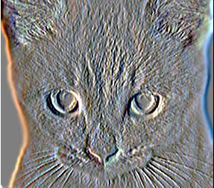
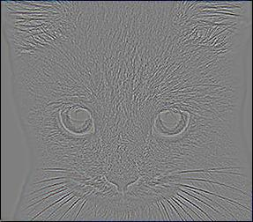
Part 1: Image filtering
Sobel filter
[insert the results from project-1.ipynb using 1b_cat.bmp with the Sobel filter here]
Discrete Laplacian filter
[insert the results from project-1.ipynb using 1b_cat.bmp with the discrete Laplacian filter here]

Slide 5
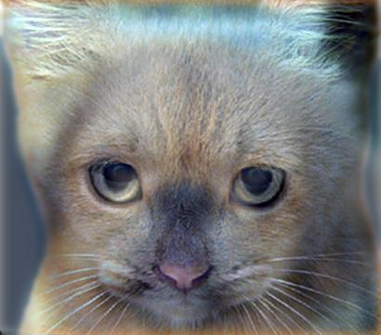
Part 1: Hybrid images
create_hybrid_image takes two images. It applies a low_pass filter to the first image and which removes high frequency details from the image. This results in a low_frequency image. Then it takes the low_pass filter of the second image as well. We can compute the high frequency by subtracting its low frequency from the original image. Adding the low_frequency from the first image and the high frequency from the second image gives us the hybrid image. I also clip the hybrid image so that no pixels exceed the range of values.
Cat + Dog
[insert your hybrid image here]
Cutoff frequency: 7

Slide 6
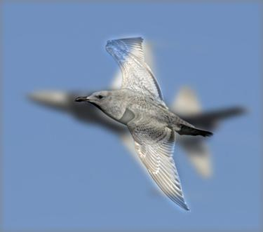
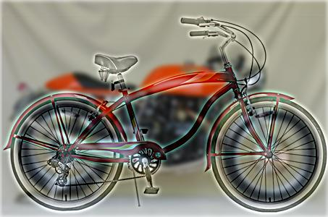
Part 1: Hybrid images
Motorcycle + Bicycle
[insert your hybrid image here]
Cutoff frequency: 3
Plane + Bird
[insert your hybrid image here]
Cutoff frequency: 5

Slide 7
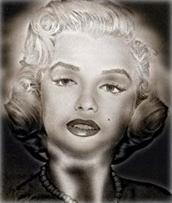
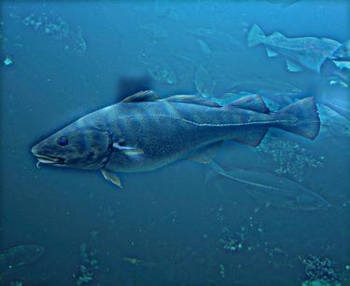
Part 1: Hybrid images
Einstein + Marilyn
[insert your hybrid
Cutoff frequency: 4
Submarine + Fish
[insert your hybrid image here]
Cutoff frequency: 4

Slide 8
Part 2: Hybrid images with PyTorch
Cat + Dog
[insert your hybrid image here]
Motorcycle + Bicycle
[insert your hybrid image here]

Slide 9
Part 2: Hybrid images with PyTorch
Plane + Bird
[insert your hybrid image here]
Einstein + Marilyn
[insert your hybrid image here]

Slide 10
Part 2: Hybrid images with PyTorch
Submarine + Fish
[insert your hybrid image here]
Part 1 vs. Part 2
2.196 seconds for Part 1
0.167 seconds for Part 2

Slide 11
Part 3: Understanding input/output shapes in PyTorch
[Consider a 1-channel 5x5 image and a 3x3 filter. What are the output dimensions of a convolution with the following parameters?
Stride = 1, padding = 0? (1, 3, 3)
Stride = 2, padding = 0? (1, 2, 2)
Stride = 1, padding = 1? (1, 5, 5)
Stride = 2, padding = 1?] (1, 3, 3)
[What are the input & output dimensions of the convolutions of the dog image and a 3x3 filter with the following parameters:
Stride = 1, padding = 0 (3, 359, 408)
Stride = 2, padding = 0 (3, 180, 204)
Stride = 1, padding = 1 (3, 361, 410)
Stride = 2, padding = 1?] (3, 181, 206)

Slide 12
Part 3: Understanding input/output shapes in PyTorch
We applied 12 filters to the dog image.
The filter size (k) is used to reduce dimensions as it slides over sections of the input. The input dimensions will reduces the bigger the filter is. The (p) is the padding which adds borders to the input. This is to solve the issue of losing edges of the images during convolution since filler is added.
The (s) dictates how far the filter moves in the image. Using these variables allows the formula to calculate how many positions the filter can fit in a specific height and width.

Slide 13
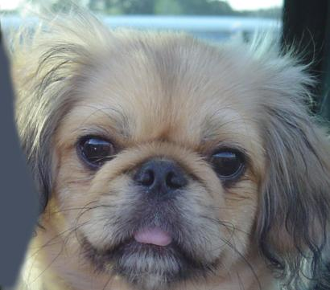

Part 3: Understanding input/output shapes in PyTorch
[insert visualization 0 here]
[insert visualization 1 here]

Slide 14
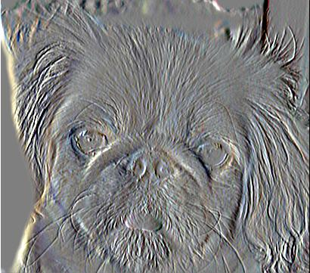
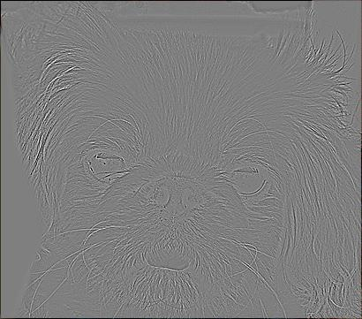
Part 3: Understanding input/output shapes in PyTorch
[insert visualization 2 here]
[insert visualization 3 here]

Slide 15
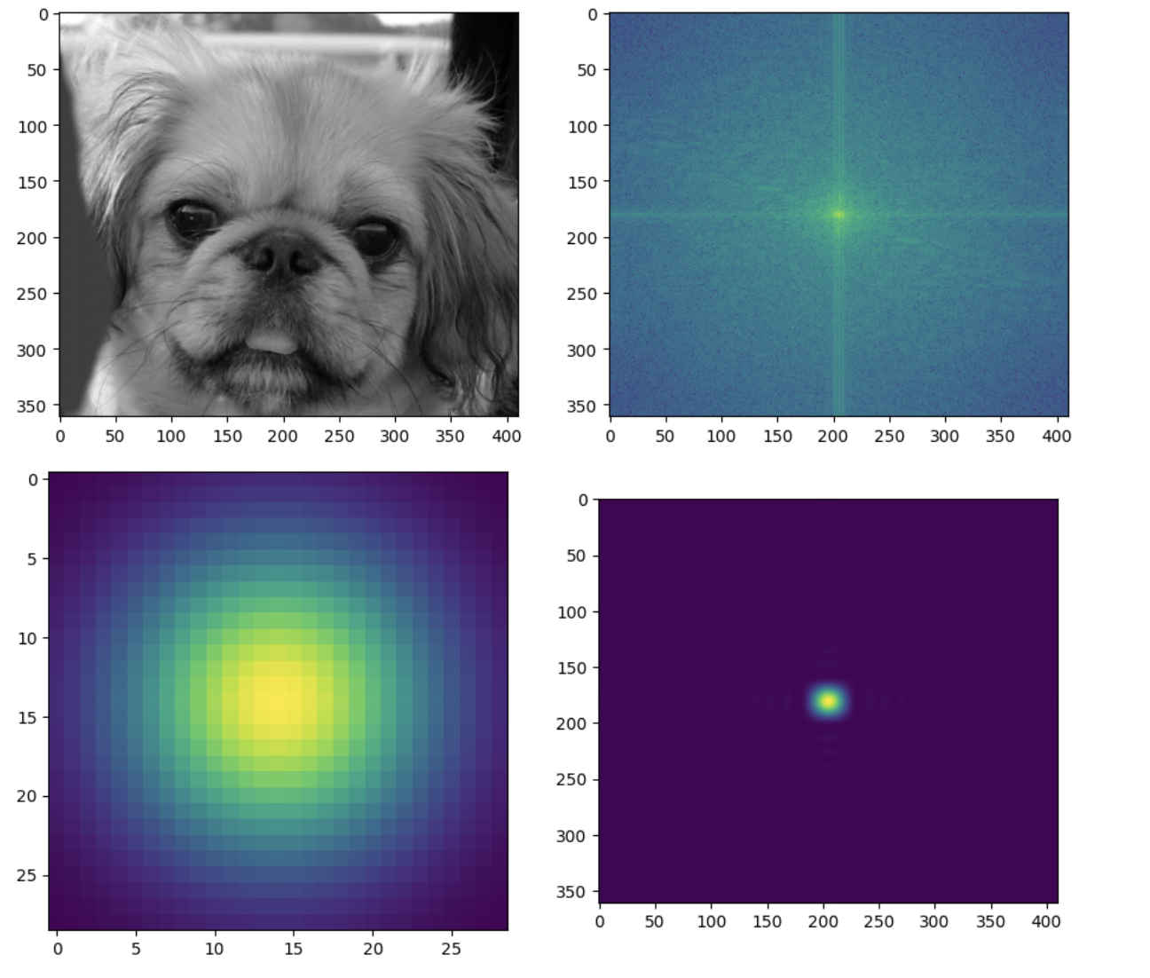
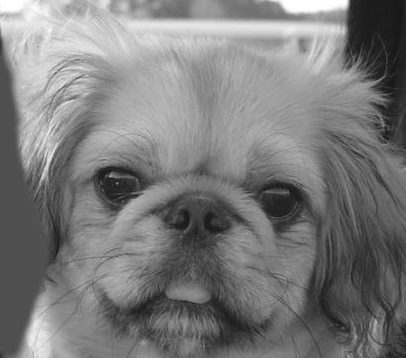
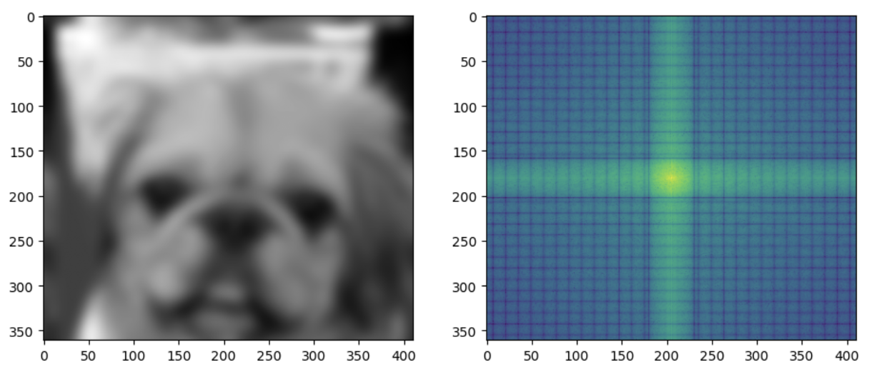
Part 4: Frequency Domain Convolutions
[Insert the visualizations of the dog image in the spatial and frequency domain]
[Insert the visualizations of the blurred dog image in the spatial and frequency domain]

Slide 16
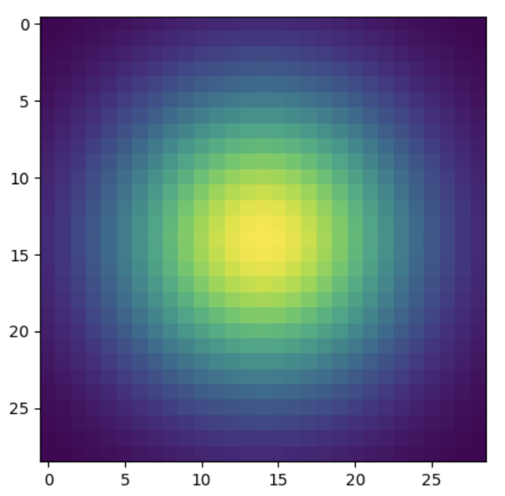
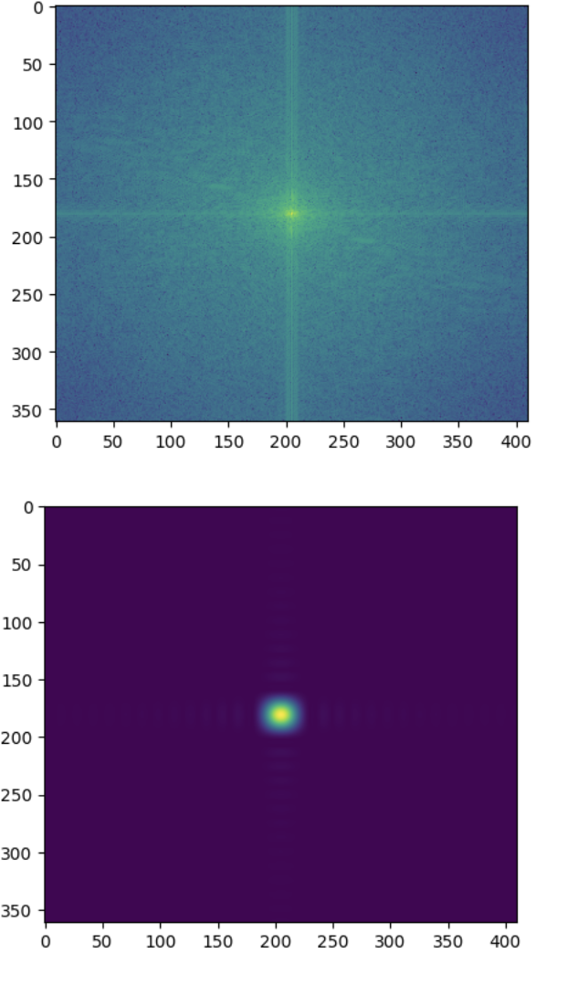
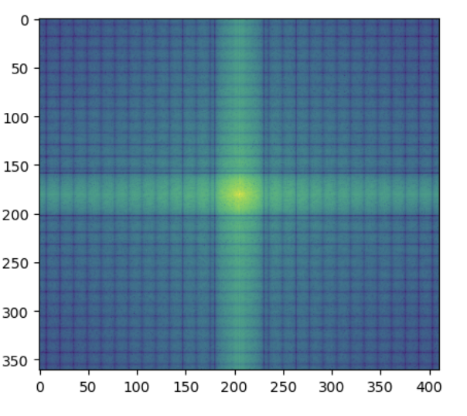
Part 4: Frequency Domain Convolutions
[Insert the visualizations of the 2D Gaussian in the spatial and frequency domain]
When trying lower cutoff frequencies the Gaussian is narrower in the special domain while it is wider in the frequency domain. This is because narrow functions become broad in frequency. When having a high cutoff the Gaussian filter is wider in the spatial while the frequency domain is narrower. Broad function transforms into a narrow function. This happends because of the scaling property of Fourier Transform.

Slide 17
Part 4: Frequency Domain Convolutions
I can explain this using a hypothetical. When there is an image and we blur it using a filter this is called convolution. Then the original and blurred image is used to create a new blurred image. The Convolution theorem says that instead of doing in the spatial domain we can just Fourier Transform the image and the filter while multiplying them to get the blurred image. When we want to recover the original image from the blurred image this is called deconvolution. Convolution is multiplication in the frequency space while deconvolution is division in the frequency space.

Slide 18
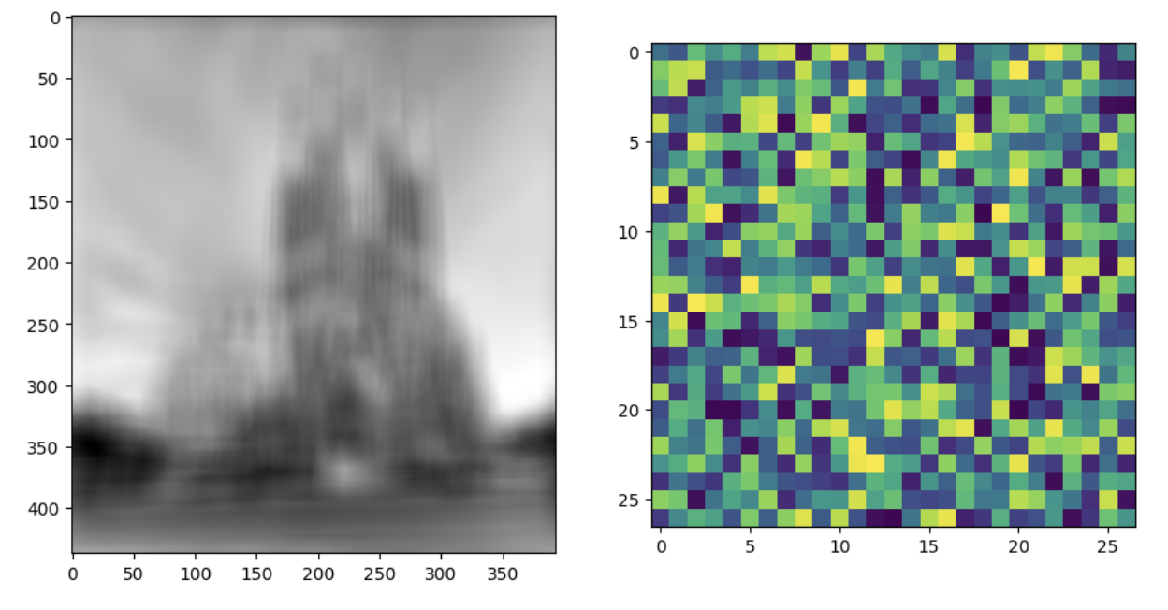
Part 4: Frequency Domain Convolutions
[Insert the visualizations of the mystery image in the spatial and frequency domain]
[Insert the visualizations of the mystery kernel in the spatial and frequency domain]

Slide 19
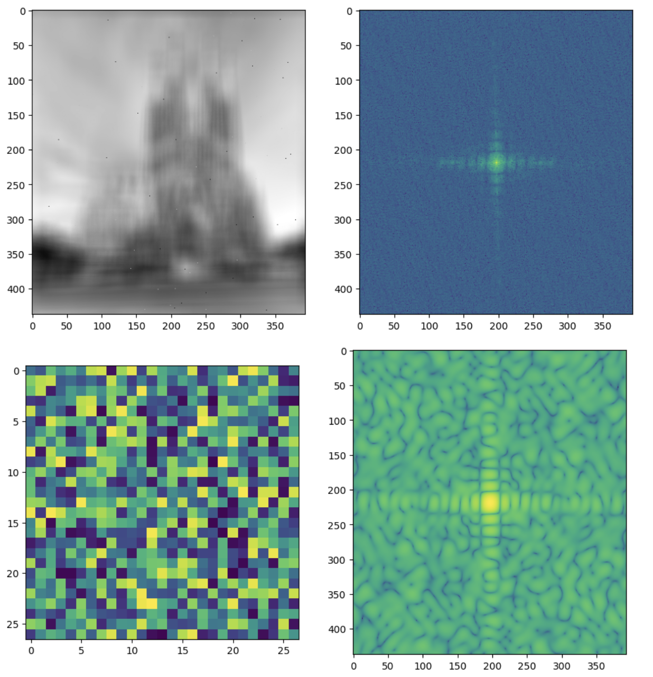
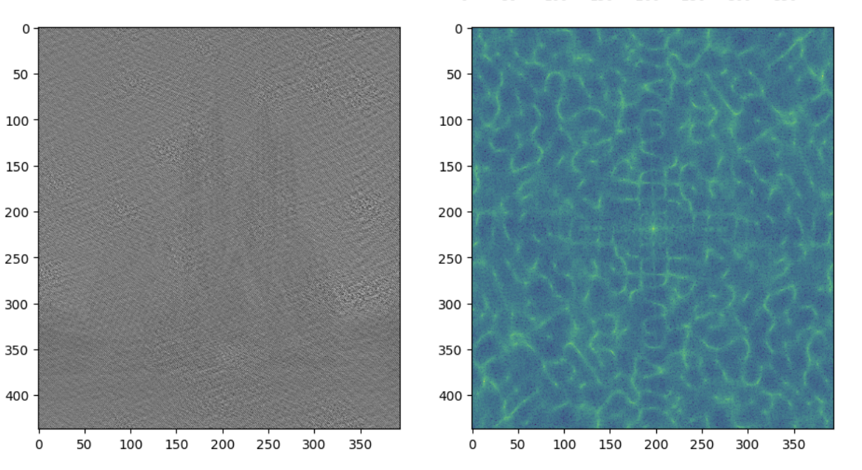
Part 4: Frequency Domain Convolutions
[Insert the de-blurred mystery image and its visualizations in the spatial and frequency domain]
[Insert the de-blurred mystery image and its visualizations in the spatial and frequency domain after adding salt and pepper noise]

Slide 20
Part 4: Frequency Domain Convolutions
One thing that limit is that it increases noise in the output image. This can cause issues when used in MRI or CT scans for medical imaging. Altered images can cause dangerous diagnosis limiting its use. Another thing is the loss of information from original data. An important photo might not have all the details after deconvolution which could be crucial information in crime scenes.
There is a central spot in the frequency domain which is bright because there is a concetration of low-frequency components. There is also a cross like structure which means there are directional patterns in the image. Sharp vertical or horizontal edges. There is also a grid like structure which means there are scattered frequencies.

Slide 21
Conclusion
Changing the cutoff dictates how much of the low and high frequencies are in their respective images. When there is a lower cutoff the low-pass filter is smoother and the hybrid image has dominating low features. The high features are less visible. When the cutoff is higher the low pass image has more details and the high pass image has sharp details. This causes the hybrid image to blend with the low image. The cutoff is important to change how much detail there is in low-pass and high pass images.

